Slide 1

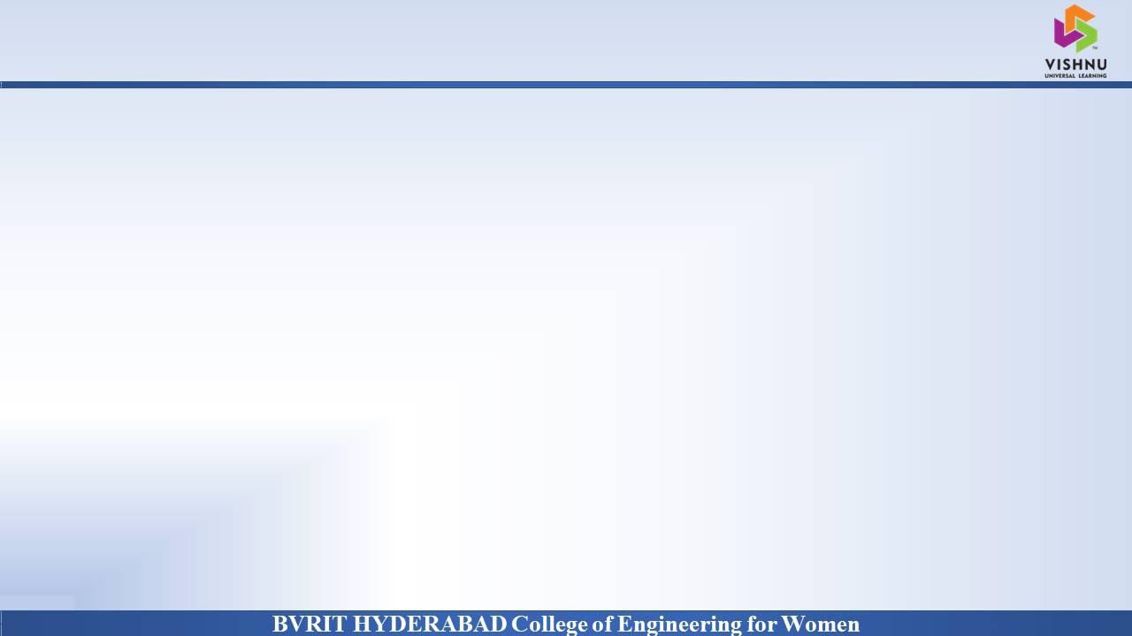
Department of Computer Science and Engineering
Survival Of Heart Failure Prediction Using Feature Scaling
Date: 28 May 2021
SHAMINI : 17WH1A0556
TRIPURA : 17WH1A0521
NITHYA SRI : 17WH1A0503
Internal Guide : Ms. Naga Kalyani Designation : Assistant Professor

Slide 2


Abstract
Why Should I Study this course?
Examples
BVRIT HYDERABAD College of Engineering for Women
Problem Statement:
To predict the survival of heart failure patients using biomedical data collected from Faisalabad Institute of Cardiology and at the Allied Hospital in Faisalabad.
Project Objective:
Heart failure prediction can be an effective tool, both to predict the survival of each patient having heart failure symptoms and to detect the most important clinical features (or risk factors) that may lead to heart failure.

Slide 3

ARCHITECTURE
Why Should I Study this course?
Examples
BVRIT HYDERABAD College of Engineering for Women
Data Acquisition
Applying classification algorithms
Feature scaling
Model tuning
Data interpretation
Dataset Analysis

Slide 4
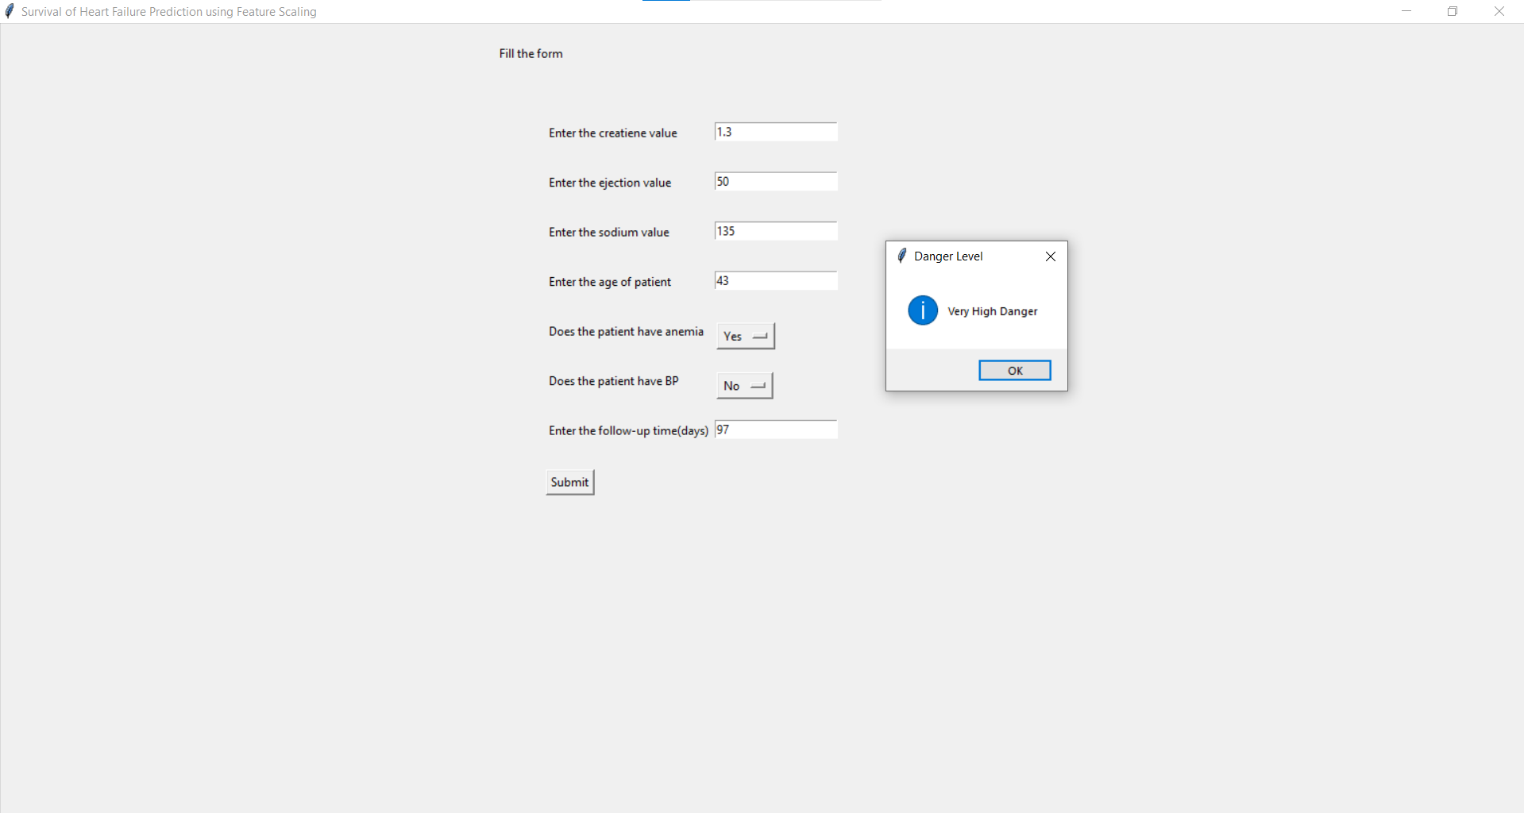
OUTPUT
Why Should I Study this course?
Examples
BVRIT HYDERABAD College of Engineering for Women

Slide 5
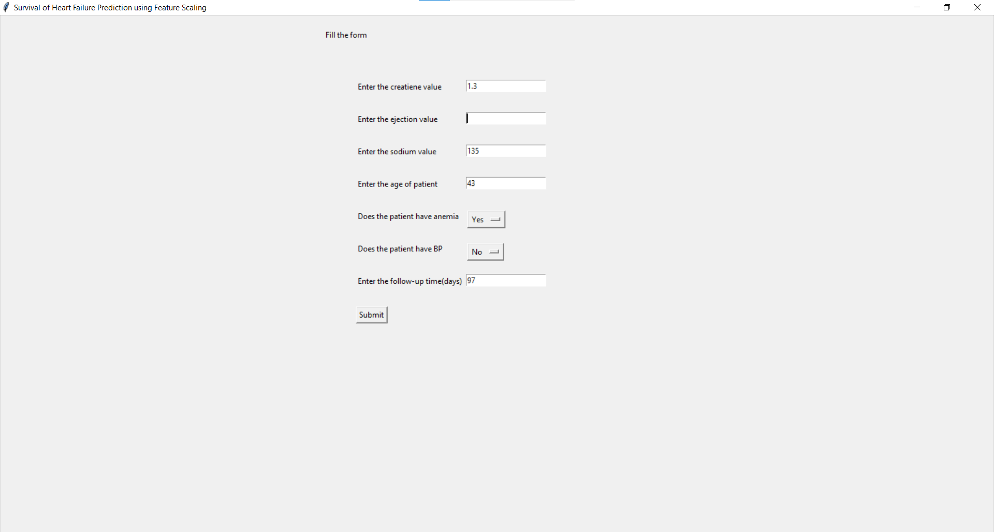
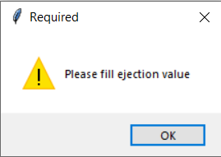
TESTCASES
Why Should I Study this course?
Examples
BVRIT HYDERABAD College of Engineering for Women
Case-1:

Slide 6
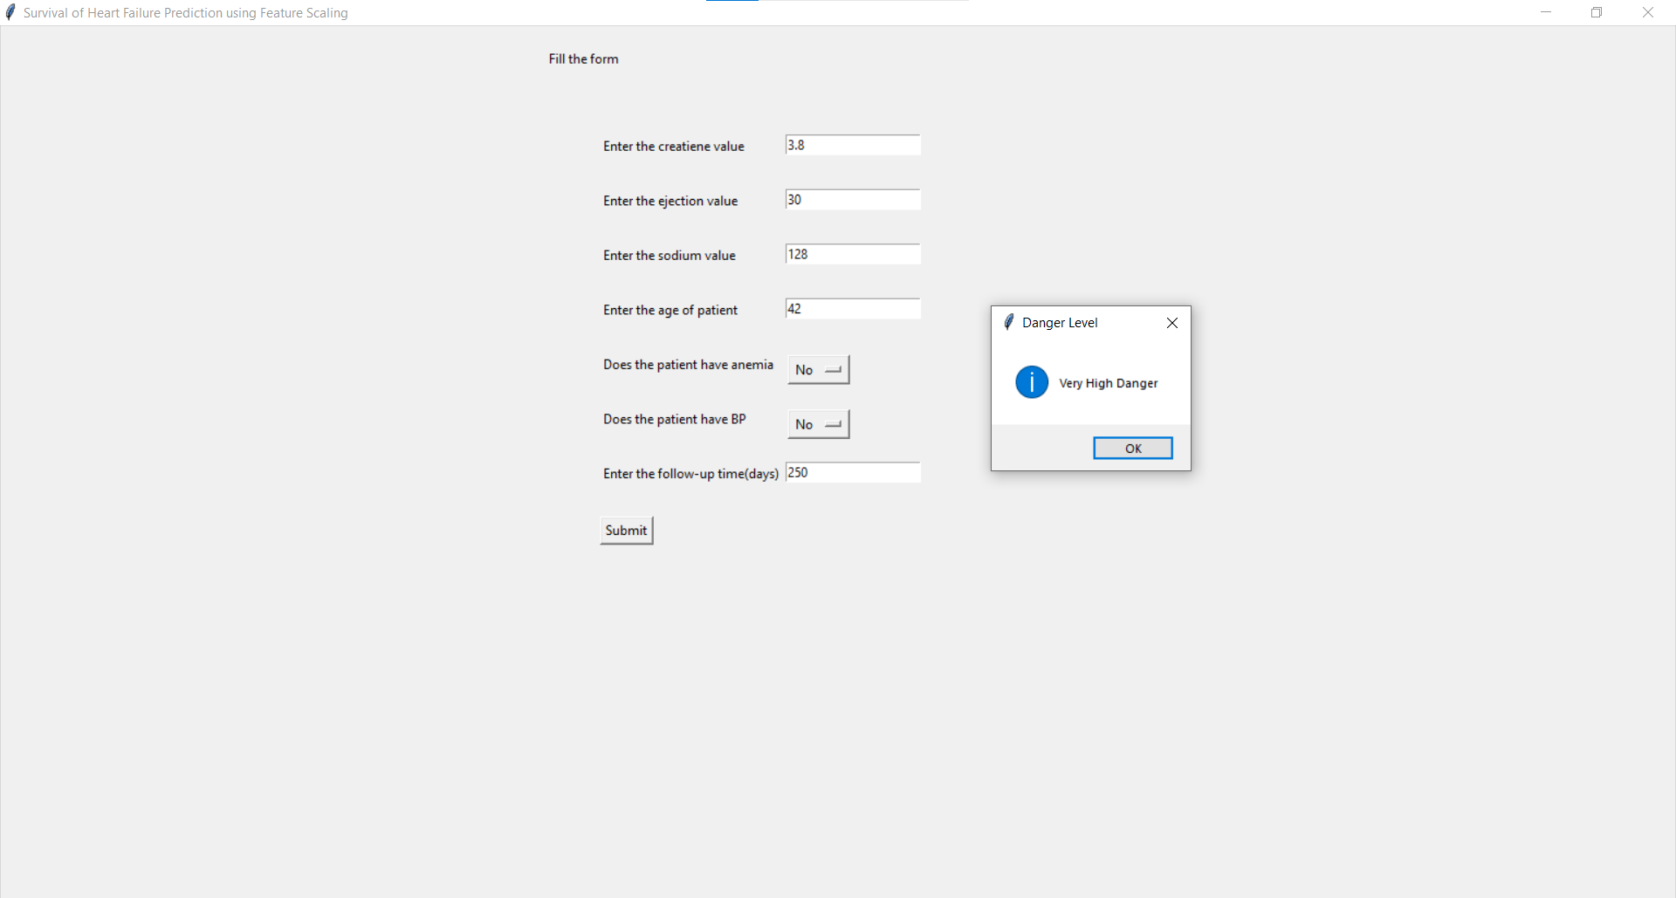
TESTCASES
Why Should I Study this course?
Examples
BVRIT HYDERABAD College of Engineering for Women
Case-2:

Slide 7

TESTCASES
Why Should I Study this course?
Examples
BVRIT HYDERABAD College of Engineering for Women
Case-3:

Slide 8
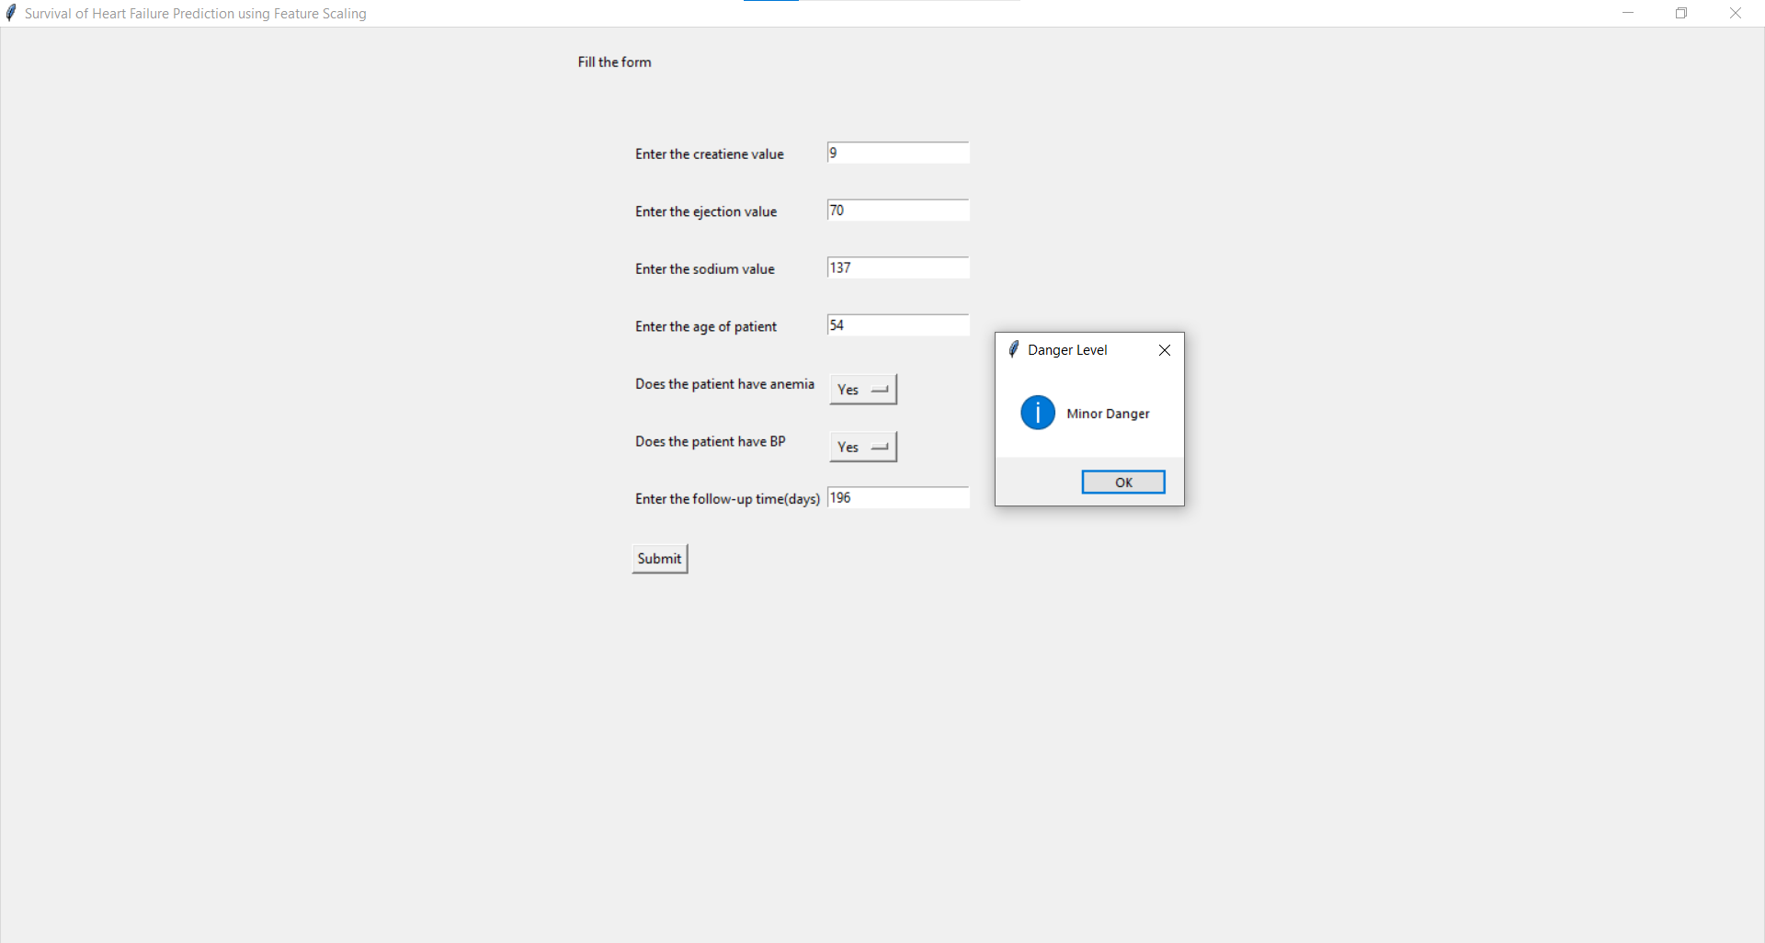
TESTCASES
Why Should I Study this course?
Examples
BVRIT HYDERABAD College of Engineering for Women
Case-4:

Slide 9
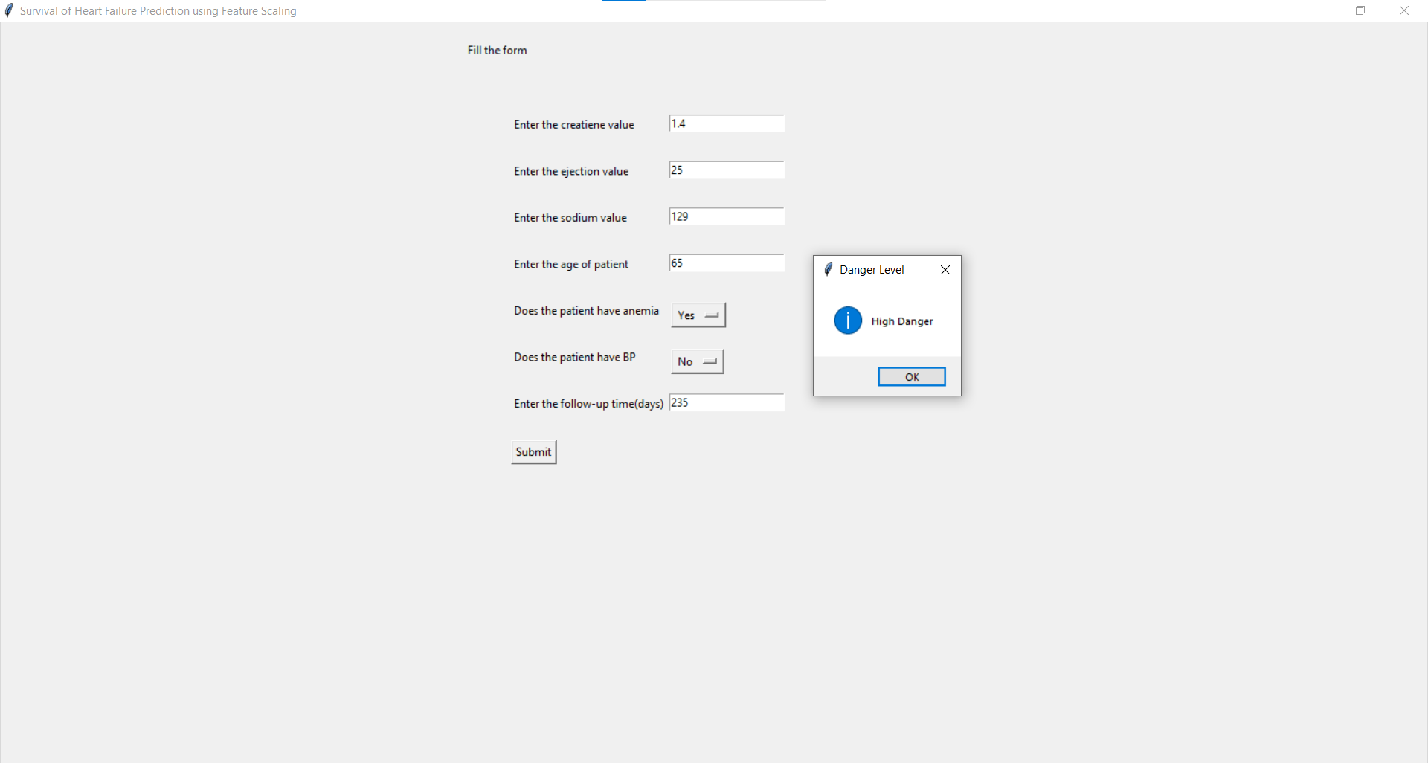
TESTCASES
Why Should I Study this course?
Examples
BVRIT HYDERABAD College of Engineering for Women
Case-5:

Slide 10
Technology Stack
Why Should I Study this course?
Examples
BVRIT HYDERABAD College of Engineering for Women
Supervised Machine Learning
Python Language
Libraries Used:
sklearn
pandas
numpy
tkinter

Slide 11
System Requirements
Why Should I Study this course?
Examples
BVRIT HYDERABAD College of Engineering for Women
ENVIRONMENT | SPECIFICATIONS
HARDWARE | Processor - Intel Core i5 Memory(RAM) - 8 GB Storage – I TB
SOFTWARE | Python OS - Windows 10 Google Colab Pycharm

Slide 12
Timeline
Why Should I Study this course?
Examples
BVRIT HYDERABAD College of Engineering for Women
REVIEW 0 | Software Requirements Data Cleaning
REVIEW 1 | Data Preprocessing Feature Ranking Implementation of algorithms
REVIEW 2 | Comparison of algorithms Design UI part
REVIEW 3 | Complete implementation Results & Discussions Project Report Draft

Slide 13
References
Why Should I Study this course?
Examples
BVRIT HYDERABAD College of Engineering for Women
[1] Base paper
https://bmcmedinformdecismak.biomedcentral.com/articles/10.1186/s12911-020-1023-5
[2] Reference papers
https://papers.ssrn.com/sol3/papers.cfm?abstract_id=3759562
[3] Data Base source links
https://www.kaggle.com/andrewmvd/heart-failure-clinical-data

Slide 14
Thank you

